Slide 1


Mini Project (CSE7102)
REVIEW-1
29-08-2026
Presidency
School of Computer Science and Engineering

Slide 2
EMERGENCY SHELTER ALLOCATION PLATFORM
CSS7102- Mini Project Review-1
Project ID: PRJ_465
Panel No: 27
Group members details:
Under the Supervision of,
Irfan Rajab Bhatt
Associate Professor
School of Computer Science and Engineering
Presidency University
Sr.No | Student Name | Roll Number
1 | Sharan Poojari | 20231ISE0089
2 | Suhas S Kattimani | 20231ISE0090
3 | Harshil Gurjar | 20231ISE0056
Name of the Program(s): B-Tech in ISE
Name of the HoD : Dr. Gopal K Shyam
Name of the Program Project Coordinator : Irfan Rajab Bhatt
Name of the School Project Coordinators: Mr. Muthuraju V

Slide 3
INDEX
Problem Statement
Git Hub Link
Introduction
Literature Review
Architecture Diagram
Analysis of Problem Statement/Output Expected
Timeline of the Project(Gantt Chart)
References

Slide 4
Problem Statement Number:
Category : Software
Problem Description : At times of disasters, individuals might have difficulties in determining the right shelters to go into based
on such factors as location, capacity, accessibility, availability of facilities, among others. There is a likelihood of shelter
overcrowding, increased travel time and inefficiency of available shelters. The following is a list of some key problems.
Key Problems :
Difficulty in finding suitable shelters quickly.
Risk of shelter overcrowding.
Longer travel and evacuation time.
Lack of centralized shelter information.
Inefficient utilization of shelter capacity.
Difficulty considering accessibility and facilities.

Slide 5
GitHub Link :
https://github.com/HarshilxAI/Emergency-Shelter-Allocation-Platform
GitHub Contributors:
Harshil Gurjar
Suhas S Kattimani
Sharan Poojari
Project Materials & Development Work:
Project execution plan and development roadmap
Problem analysis and proposed solution strategies
Technology stack and API / open-source resource selection
System architecture and workflow planning
Supporting project document and implementation notes
Repository Work:
Project repository setup
Planning and documentation
Architecture & implementation planning
API/ open-source resource evaluation

Slide 6
Introduction
About the Project:
Emergency Shelter Allocation Platform is a software-based web application designed to help affected people and
emergency administrators identify suitable shelters during disasters. It uses shelter information such as location,
capacity, occupancy, facilities, and current status to support faster and more efficient shelter allocation. The platform
filters and ranks available shelters based on user requirements and provides clear shelter recommendations.
Key Objectives:
Faster identification of suitable shelters.
Capacity-aware shelter allocation.
Reduction of shelter overcrowding.
Centralized and updated shelter information.
Clear decision support for emergency response.

Slide 7
Literature Review
No. | Paper referred | Contribution / relevance to project
1 | Yang et al. (2015) — Intelligent Shelter Allotment for Emergency Evacuation Planning | Introduces CARES for assigning routes, exits and shelters while reducing crowd movement conflicts.
2 | Zhang et al. (2016/17) — Optimal Resource Allocation in Emergency Management | Uses decentralized multi-agent allocation to assign emergency resources under time and cost constraints.
3 | Wang et al. (2020) — Emergency Resource Allocation for Multi-Period Post-Disaster | Models uncertain, multi-period relief allocation and routing using multi-objective optimization.
4 | Amiran et al. (2025) — ML for Earthquake Emergency Evacuation | Applies machine learning to emergency evacuation-center site selection and neighborhood navigation.
5 | Sarma et al. (2020/2022) — Cost Minimization Resource Allocation for Disaster Relief | Combines crowdsourced information, MCDM and optimization to improve disaster-relief resource allocation.
6 | Li, Li & Wang (2009) — Emergency Service Facility Location | Formulates facility-location and algorithmic approaches relevant to locating emergency service facilities.
7 | Tanti et al. (2022) — Dynamic Facility-Location After Disaster | Considers uncertain demand, capacity, cost and travel time for dynamic emergency facility location and routing.
8 | Cui et al. (2019) — Emergency Material Allocation After Disaster | Considers disrupted supply chains and route risk; optimizes transport time and cost.
9 | Rodríguez-Espíndola (2022/2024) — Multi-Period Disaster Management | Jointly considers facility location, resource allocation and distribution across multiple disaster periods.
10 | Rajalakshmi et al. (2024) — AI for Resource Allocation in Humanitarian Aid | Highlights AI-supported demand analysis, logistics and resource-allocation decision making.

Slide 8
Architecture Diagram
Web Frontend
User & Admin Interface
Shelter Search • Map • Allocation Result
Affected User
Map / Routing
Service
Administrator
Application / API Layer
Authentication • Shelter Management • Allocation Logic • REST APIs
Routing &
Geospatial Service
Database
Shelter • Capacity • Occupancy • User • Allocation Records
Recommended Shelter
+ Route + Capacity
Notes:
We have mainly 2 users, the affected user and second one is administrator who will be working on backend.
Firstly, let’s talk about the affected user, they will be getting an interface where they can add location, number of people, and disaster type.
And they will get the output where they will be having a list of shelters which are nearest to there respective locations. And along with that they will be provided with what is the total occupancy of the shelter and how much shelter is already occupied, etc. That list will be provided as priority list where the best one will be on top and other are accordingly.
Now, comes the backend part where once the user has mentioned it’s details then backend starts working were, the nearest shelters will be shortlisted from that specific location which can be a safe place for that disaster.
Then from those shelters we will have to find a suitable shelters in which all parameters are checked like occupancy in shelter, is that shelter safe, etc. And according to that our priority list will be ready that which shelter is best for the situation.
Then for the tracking purpose which is the best path which can be taken to reach that shelter which includes (distance, travel time, routes, etc) will be analyzed and a final and safest path will be shown on dashboard.
After the completion of the process, once the people are relocated successfully then we can add that information in our database which can be used in future as well.

Slide 9
Analysis of Problem Statement /Output Expected
1. Shelter discovery: Display shelters that are currently available and relevant to the user’s location.
2. Smart ranking: Rank eligible shelters using distance, remaining capacity, suitability and facility criteria.
3. Allocation result: Show the selected/recommended shelter, available capacity, occupancy, facilities and contact details.
4. Route guidance: Present the recommended route and distance/time through the map interface.
5. Administrator view: Provide shelter registration, status/occupancy updates and allocation monitoring.
6. Decision support: Reduce manual searching and help distribute users across suitable shelters instead of overloading a single location.
Expected overall outcome: a usable web platform that converts shelter and user information into a clear, capacity-aware shelter recommendation.
Notes:
Now, let’s move to next slide About Expected Output
here comes what user will be able to access
1) Shelter discovery – it will display the shelter which are available to nearest to their location
Second one is
2) Smart Ranking – where priority ranking will be provided in which capacity, occupancy and other details will also be provided and according to that list will be prepared
third one is
3) Allocation Result – that list will be shown to the user and he/she can select the shelters according to the priority (where, elderly, disabled, etc people can go first followed by others)
fourth one is
4) Route guidance – the best route for the selected shelter will be shown using openroute service which is an open source tool which will be used for routing the best path including distance, time taken)
Fifth one is
5) Administrator view – here once the relocation of people is done then the admin can save the data which can be used in future and also constant updates will be taken from the user.
And the last one
6) Decision support – this solves the problem of the chaos happens in the disaster situation and can help the people to go in the correct direction during this kind of disasters
since in this kind of incident what happens is all people gets panic and runs on random places, which won’t happen if they have a correct guidance and the support from the local teams helping there

Slide 10
Analysis of Problem Statement (contd...)
Software Requirements
• Frontend: React.js, HTML5, CSS3 / responsive UI
• Backend: Node.js with Express.js and REST APIs
• Database: PostgreSQL (PostGIS-ready for geospatial data)
• Maps & routing: OpenStreetMap with Leaflet; routing API/service
• Development tools: Visual Studio Code, Git, GitHub, npm
• Testing: Postman and browser developer tools
• Deployment: GitHub-based workflow with a cloud hosting platform
Hardware Requirements
• No dedicated hardware is required.
• Development/testing can be performed on a standard laptop/desktop with internet access.
Notes:
Let’s come to the requirements of the Proejcts
Firstly the s/w req.
Frontend we will be using react js , html and css as they are easy to be deployed and we can make a perfect responsive ui for them
in backend we will go with node js with express js which is used to build fast, scalable, and high-performance backend server
and rest api to exchange data and communicate with other devices over the internet.
In database we will use postgre sql to store the data which is provided by user and data of the disaster which is held on particular locations
maps and routing we are using open street map as I mentinod before for routing and path selection and to calculate travel time purpose and also this is a free to use tool and easy to integrate with the project
in development tool, we will be using vscode git and github and npm(which is default manager of js) to run our programs
for testing purposes we will go with postman(used for automated, and backend API testing) and browser developer tool (used for live frontend debugging, real-time network analysis)
for deployment which is one of the most important part we will go with github based cloud hosting platform where we can deploy backend as well as frontend easily.
Now the hardware part, as our project is mainly the software based project we don’t need any hardware requirements
for testing purpose we will just use different devices like laptop, smart phone , desktop etc
that’s from my side now my teammate will be continuing with function workflow of the project.

Slide 11
Analysis of Problem Statement
Proposed Functional Workflow
1
User / Admin
Login or access
2
Enter location
& requirements
3
Fetch shelters
& current status
4
Filter by
capacity / suitability
5
Rank by distance,
capacity & suitability
6
Display shelter
+ route + details
7
Record allocation
& update occupancy
Allocation logic: remove unavailable shelters → check capacity → check disaster/shelter suitability → calculate distance → apply ranking score → return the best feasible shelter(s). The administrator can update shelter capacity/occupancy, after which recommendations are recalculated.
The system is designed as a decision-support platform; final emergency decisions remain with authorized personnel.

Slide 12
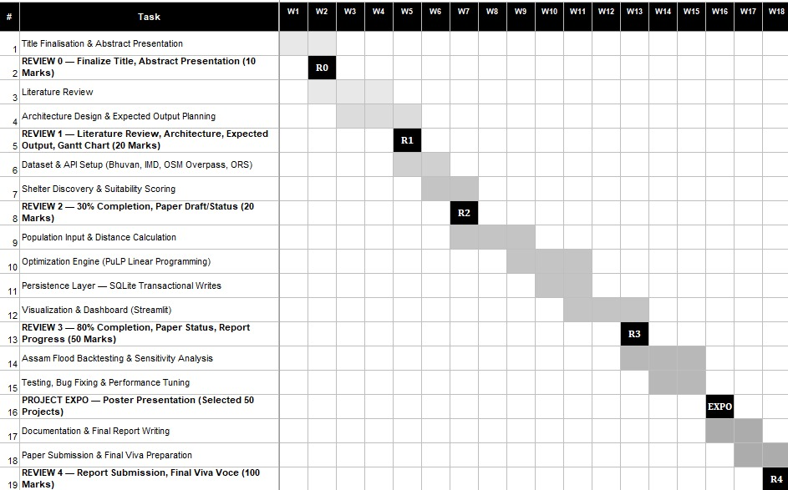
Timeline of the Project (Gantt Chart)

Slide 13
References (IEEE Paper format)
APA-style citations with direct DOI / IEEE Xplore links
[1] Yang, K., Shekhar, A. H., Rehman, F. U., Lahza, H., Basalamah, S., Shekhar, S., Ahmed, I., & Ghafoor, A. (2015). Intelligent shelter allotment for emergency evacuation planning: A case study of Makkah. IEEE Intelligent Systems, 30(5), 66–76. https://doi.org/10.1109/MIS.2015.39
[6] Li, D., Li, Y., & Wang, L. (2009). Model and algorithms for emergency service facility location problem. In 2009 IITA International Conference on Services Science, Management and Engineering (SSME), 15–18. https://doi.org/10.1109/SSME.2009.80
[2] Zhang, J., Zhang, M., Ren, F., & Liu, J. (2016). An innovation approach for optimal resource allocation in emergency management. IEEE Transactions on Computers. https://doi.org/10.1109/TC.2016.2601331
[7] Tanti, L., Efendi, S., Lydia, M. S., & Mawengkang, H. (2022). Designing an optimization model for dynamic facility-location problem at post-disaster area considering uncertainty. In 2022 4th International Conference on Cybernetics and Intelligent System (ICORIS), 1–6. https://doi.org/10.1109/ICORIS56080.2022.10031495
[3] Wang, F., Pei, Z., Dong, L., & Ma, J. (2020). Emergency resource allocation for multi-period post-disaster using multi-objective cellular genetic algorithm. IEEE Access, 8, 82255–82265. https://doi.org/10.1109/ACCESS.2020.2991865
[8] Cui, S., Liu, S., Tang, X., & Zhu, T. (2019). Emergency material allocation problem considering post-disaster impact. In 2019 8th International Conference on Industrial Technology and Management (ICITM), 290–294. https://doi.org/10.1109/ICITM.2019.8710729
[4] Amiran, A., Behnam, B., & Seyedin, S. (2025). Machine learning for earthquake emergency evacuation: Site selection and neighborhood navigation. IEEE Access, 13, 91595–91610. https://doi.org/10.1109/ACCESS.2025.3573207
[9] Rodríguez-Espíndola, O. (2022). Multi-period model for disaster management in simultaneous disasters. IEEE Transactions on Engineering Management, 71, 4971–4984. https://doi.org/10.1109/TEM.2022.3227329
[5] Sarma, D., Das, A., Bera, U. K., & Singh, A. (2020). A cost minimization resource allocation model for disaster relief operations with an information crowdsourcing-based MCDM approach. IEEE Transactions on Engineering Management, 69(5), 2454–2474. https://doi.org/10.1109/TEM.2020.3015775
[10] Rajalakshmi, B., Aswini, P., Thethi, H. P., Goyal, H. R., Sravanthi, J., & Hameed, A. A. (2024). Utilizing artificial intelligence for efficient resource allocation and logistics in humanitarian aid. In 2024 1st International Conference on Sustainable Computing and Integrated Communication in Changing Landscape of AI (ICSCAI), 1–6. https://doi.org/10.1109/ICSCAI61790.2024.10866107

Slide 14


